Slide 1

HIV and AIDS ChatBOT
Solent University, Department of Science and Engineering Introduction to Artificial Intelligence
Obi, Sam, Pascal, Soly, Ezinie and Amir

Slide 2

Agenda
Overview
Purpose of the Chatbot
Data
Algorithms
User Interface
Functionality
Evaluation
Comparative Analysis
User Interaction
Future Enhancements
Conclusion

Slide 3
Overview
Brief Introduction to the Chatbot
Purpose: Provide accurate and accessible information on HIV and AIDS
Machine Learning Algorithms Used
Educational Tool with a User-Friendly Interface

Slide 4
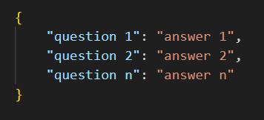
Data
Dataset Overview
Dataset Format (JSON)
Preprocessing Steps
Dataset Size (457 Q&A pairs)

Slide 5

preprocessing
Several preprocessing steps undertaken before training
Transformation of data from Excel files to JSON format
Consolidation of JSON files into a unified dataset
Addressing and rectifying instances of missing values (NaN)

Slide 6
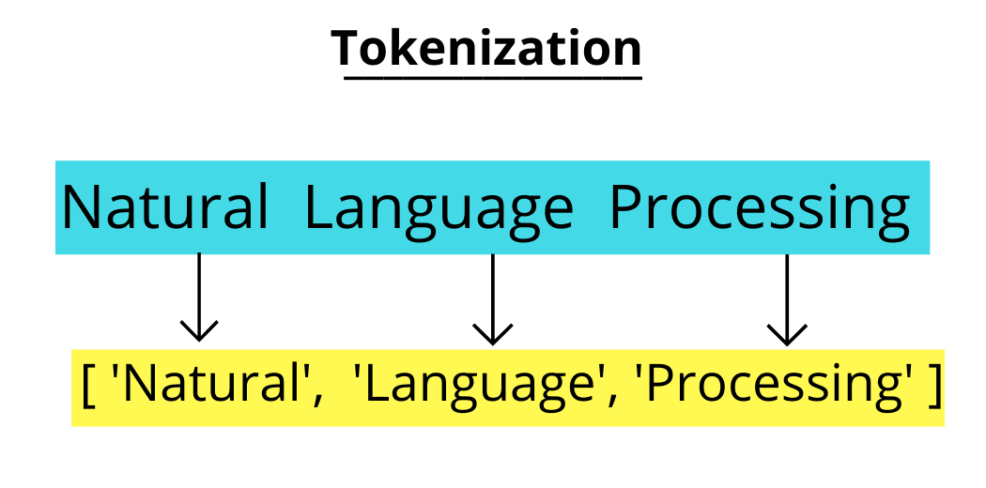
Tokenization
Process of breaking down text into smaller units (tokens)
TfidfVectorizer used for tokenization and converting tokens into numerical vectors using TF-IDF method
TF-IDF reflects the importance of a word in a document relative to a collection of documents (corpus)

Slide 7

Development Tools
Used Python for backend development
Leveraged Flask library for web application development
Utilized Scikit-learn for machine learning algorithms
Integrated HTML, CSS, and JavaScript for the user interface

Slide 8

Machine Learning Algorithms
Overview of Algorithms Used
SVM, Naïve Bayes, Decision Tree, Random Forest, KNN, Gradient Boosting, Logistic Regression, ANN

Slide 9
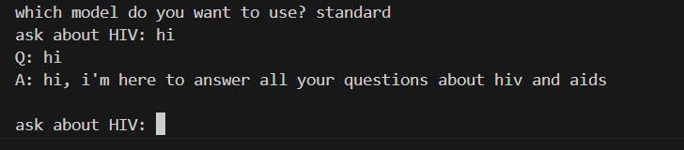
Standard Responses Function
Python function for standard responses
Uses a pre-defined dataset
Implements the get_response_standard function

Slide 10
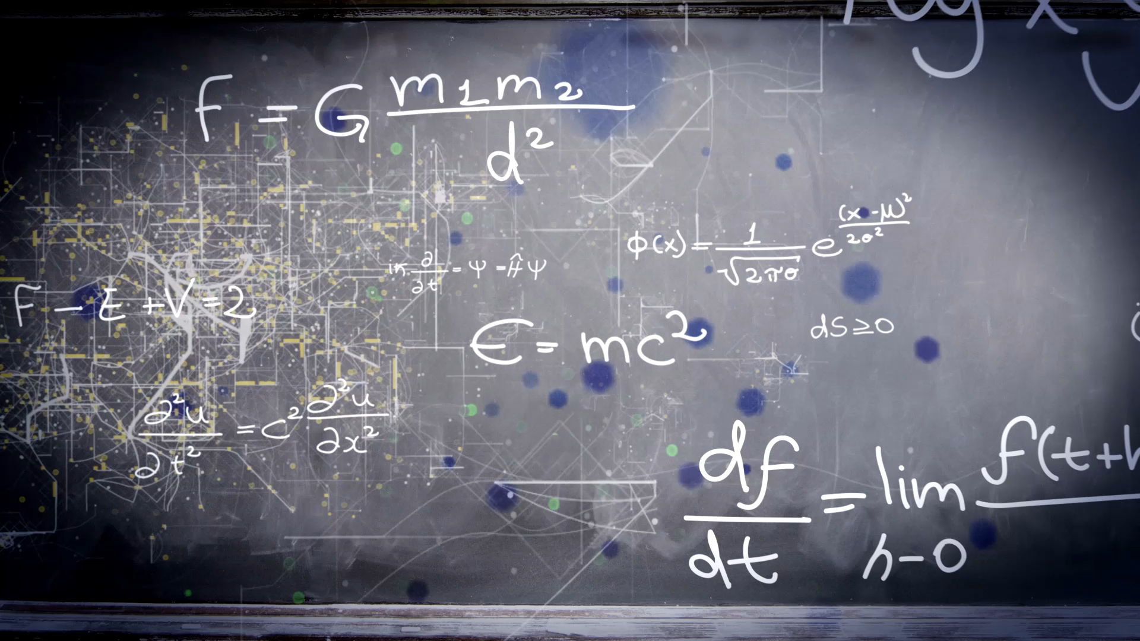
Machine Learning Algorithm Selection
Python function to select ML algorithms
Utilizes a loop for user input
Options include SVM, Naive Bayes, Random Forest, Decision Tree, KNN, Gradient Boosting, Logistic Regression, and ANN

Slide 11

Model Training Function
Python function for training ML models
Uses Scikit-learn's make_pipeline and fit methods
Incorporates TfidfVectorizer for feature extraction

Slide 12

Model Evaluation Function
Python function for evaluating ML models
Metrics include Accuracy, Precision, Recall, and F1 Score
Utilizes Scikit-learn's accuracy_score, precision_score, recall_score, and f1_score

Slide 13
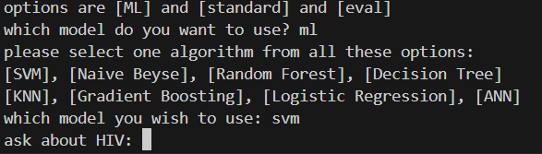
User Interaction Function
Python function for user interaction
Options include ML model interaction, standard responses, and evaluation
Uses a loop for continuous interaction
Incorporates model training and response retrieval

Slide 14
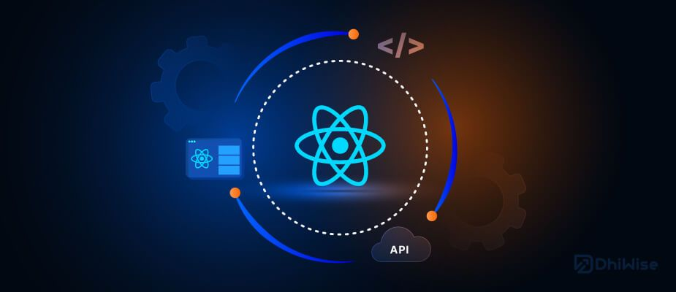
Integration with UI
Functions to integrate ML models with UI
Includes Random Forest and Decision Tree integration

Slide 15

Flask
Overview of UI using Flask
Flask Application (app.py)
Routes: Standard Responses, Decision Tree, Random Forest
Routes and HTML, CSS, JavaScript components

Slide 16
Flask Application
Serves as the backbone of the chatbot
Provides a scalable and dynamic platform
Three distinct routes for different functionalities
Standard Responses
Decision Tree (DT)
Random Forest (RF)

Slide 17
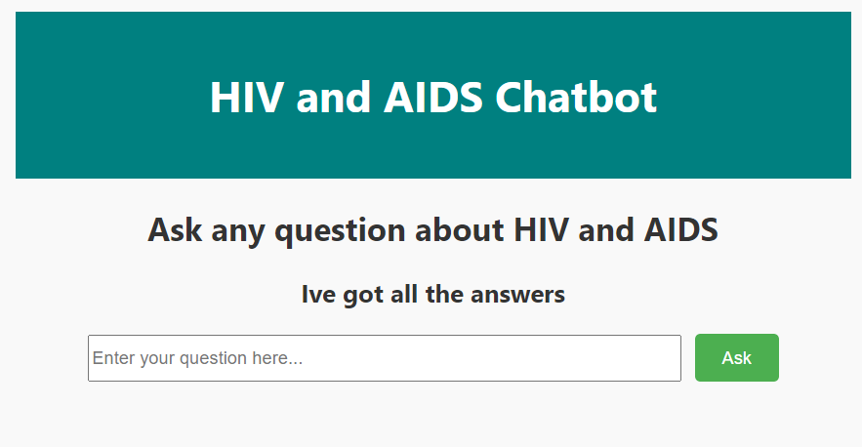
Standard Responses Route
Route for handling user queries through a conventional approach
Retrieves responses from a pre-defined dataset

Slide 18
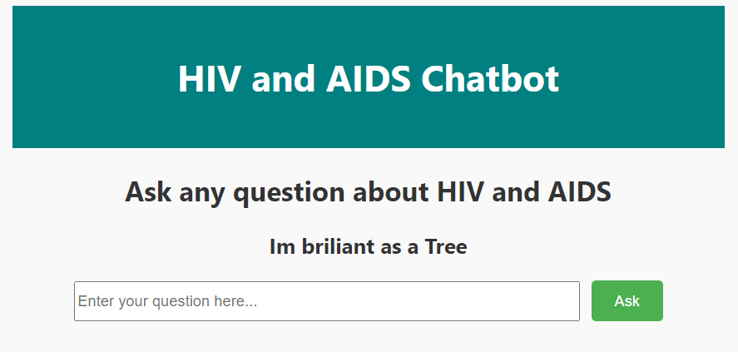
Decision Tree (DT) Route
Utilizes a Decision Tree model to analyze user queries
Generates responses based on learned patterns
Accessible at (/dt)

Slide 19
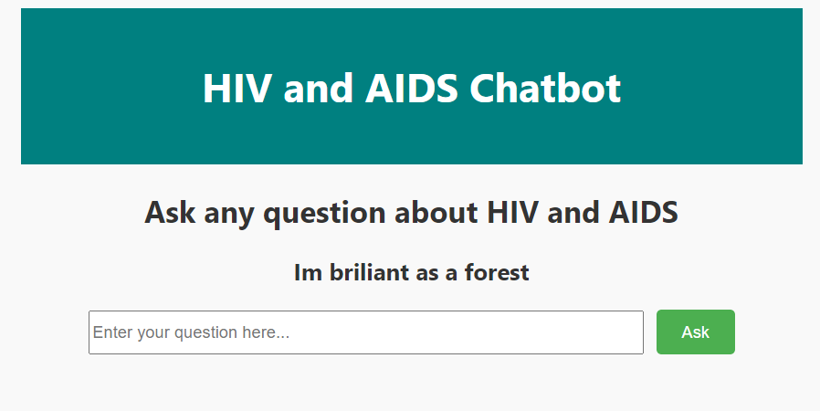
Random Forest (RF) Route
Use a Random Forest model for a better understanding
Captures diverse patterns in user queries
Accessible at (/rf)

Slide 20

HTML, CSS, JavaScript
Entire user interface constructed using Flask, HTML, CSS, and JavaScript
Three HTML files ('index.html,' 'dt.html,' 'rf.html') for different functionalities
CSS styles for a visually appealing user interface
JavaScript for smooth scrolling functionality

Slide 21

Functionality
Designed to provide a seamless and informative user experience
Categorized functionality based on different topics (Symptoms, Causes, Diagnosis, Treatments, Preventions, Living with HIV)
Three different approaches using different routes

Slide 22

Evaluation
Metrics: Accuracy, Precision, Recall, F1 Score
Chatbot Evaluation
Comparative Analysis
Algorithmic Performance
User Interaction

Slide 23
Evaluation
Algorithm | Accuracy | Precision | Precision | F1-Score
SVM | 85.75 | 96.56 | 85 | 83
Naïve Bayes | 13.16 | 95 | 13 | 9.7
Random Forest | 98.25 | 98 | 98 | 97.95
Decision Tree | 98.25 | 98.97 | 98 | 97.93
KNN | 24.12 | 71.85 | 24 | 15
Gradient Boosting | 98 | 98.88 | 98 | 97.67
Logistic Regression | 15.57 | 93 | 15 | 10
ANN | 97.59 | 98.5 | 97.58 | 97

Slide 24
Comparative Analysis
Algorithm | Accuracy | Precision | Precision | F1-Score
SVM | 85.75 | 96.56 | 85 | 83
Naïve Bayes | 13.16 | 95 | 13 | 9.7
Random Forest | 98.25 | 98 | 98 | 97.95
Decision Tree | 98.25 | 98.97 | 98 | 97.93
KNN | 24.12 | 71.85 | 24 | 15
Gradient Boosting | 98 | 98.88 | 98 | 97.67
Logistic Regression | 15.57 | 93 | 15 | 10
ANN | 97.59 | 98.5 | 97.58 | 97
Comparative analysis of all machine learning algorithms
Highlighting the strengths and weaknesses of each algorithm
Insights gained during the evaluation process

Slide 25
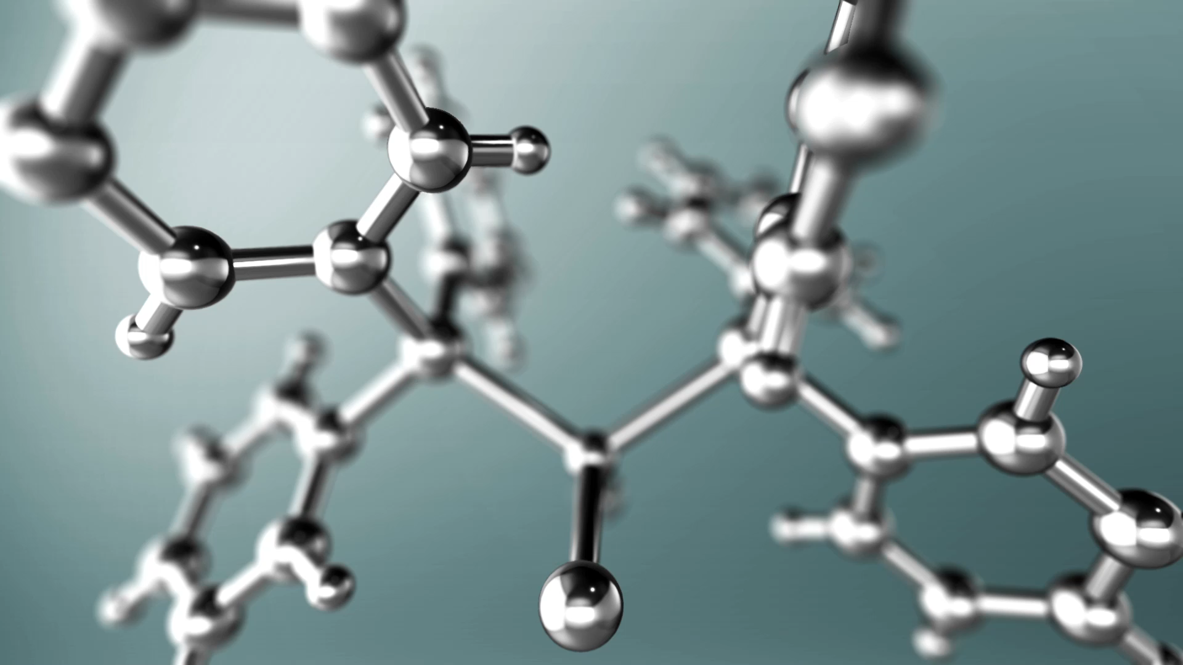
Algorithmic Selection
successful algorithms (Random Forest, Decision Tree, Gradient Boosting, and ANN)
Importance of algorithm selection based on dataset characteristics and task requirements
Continuous monitoring and adaptation for efficient and user-friendly chatbot development

Slide 26
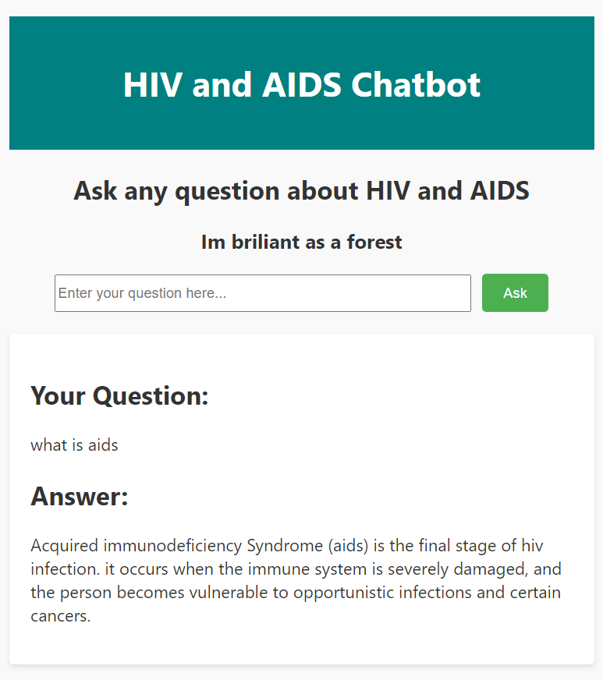
User Interaction Feedback
Feedback from user interactions
Positive experiences expressed by users
Satisfaction with the chatbot's ability to provide relevant and accurate information

Slide 27
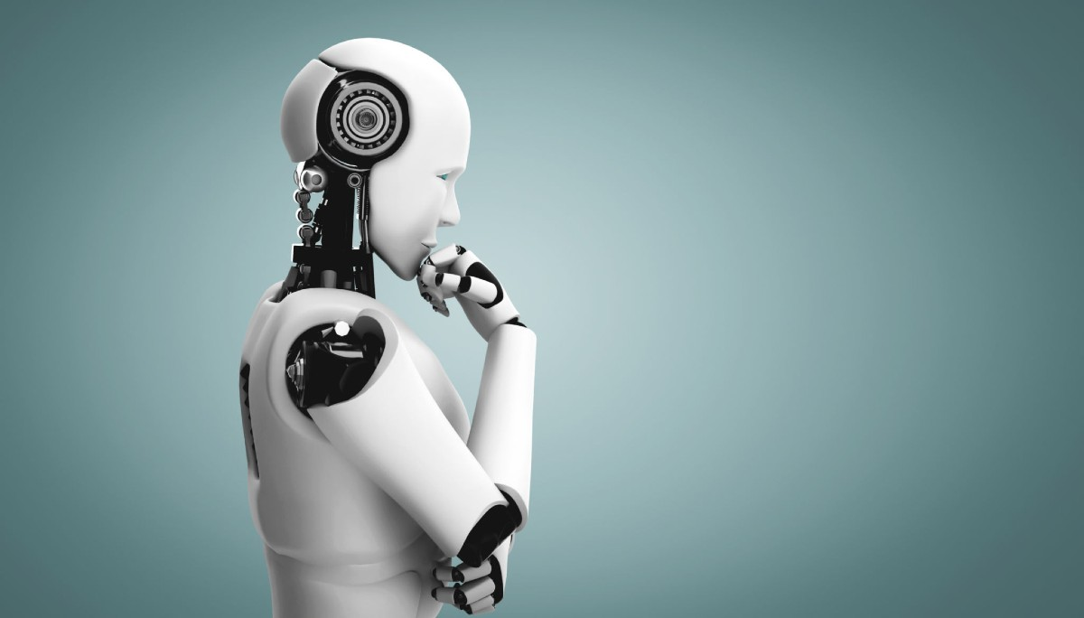
Future Enhancements
Opportunities for further refinement and enhancement
Expanding the dataset to handle a more extensive range of user queries
Exploring advanced machine learning algorithms and techniques for improved performance
Incorporating user feedback mechanisms for continuous learning and refinement

Slide 28
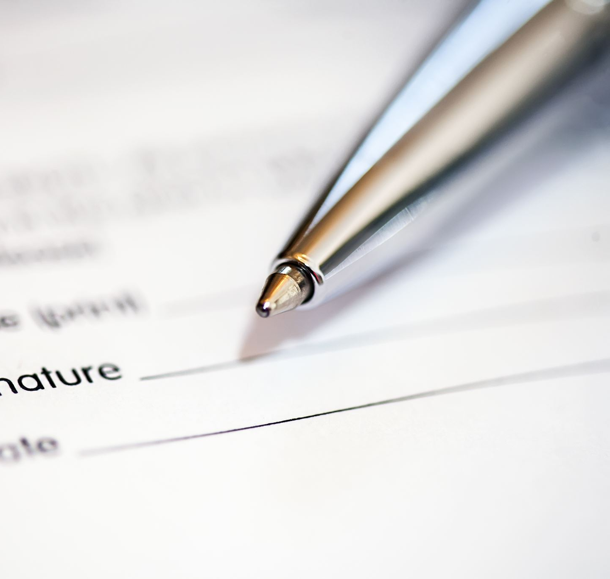
Conclusion
Summary of key findings and achievements
Successful implementation of machine learning algorithms
Positive user feedback and satisfaction
Acknowledgment of the chatbot's role in providing accurate and accessible information on HIV and AIDS

Slide 29
Thank you

